Slide 1
CYBR-486: Machine Learning - Project 4
CNN, Nearest Neighbors, and Random Forest
Seiya Genda, Nate Merz, and Solomon Preston

Slide 2
Agenda
CNN
Model
MNIST Issues
Nearest Neighbors
Code Execution
Findings
Random Forest
Model
Challenges

Slide 3
CNN

Slide 4
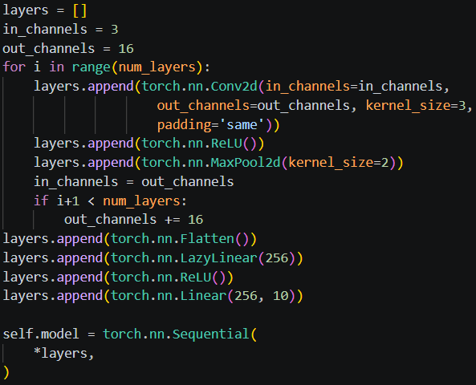
Model Testing
Multiple models were trained at a time.
For loops came in handy.
Same padding allows for easy adjustment of filter/kernel size.

Slide 5
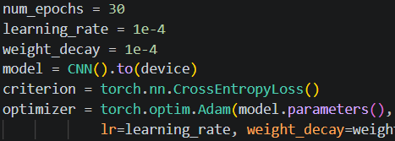

Hyperparameters

Slide 6
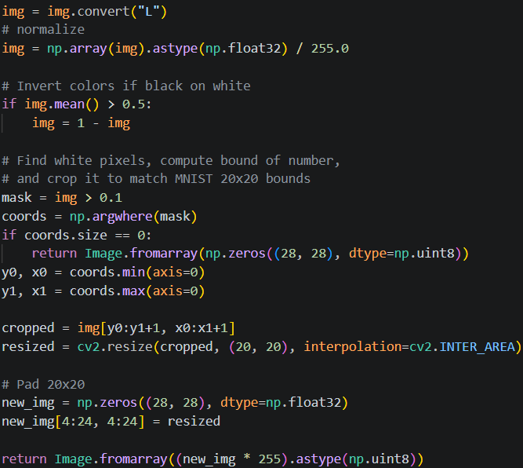

MNIST Processing
MNIST Format: 128x128 binary image.
Normalize image to 20x20, keep aspect ratio.
Pad image to 28x28.
Resultant class is called at the top of the torchvision transpose.

Slide 7
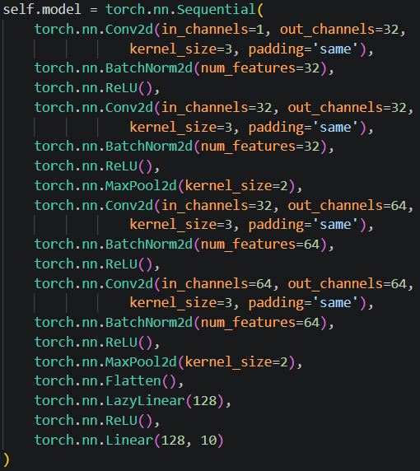


Final Model
Batch normalization stabilizes CNN through recentering and rescaling images
Two convolution layers before pooling.

Slide 8
Nearest Neighbors

Slide 9
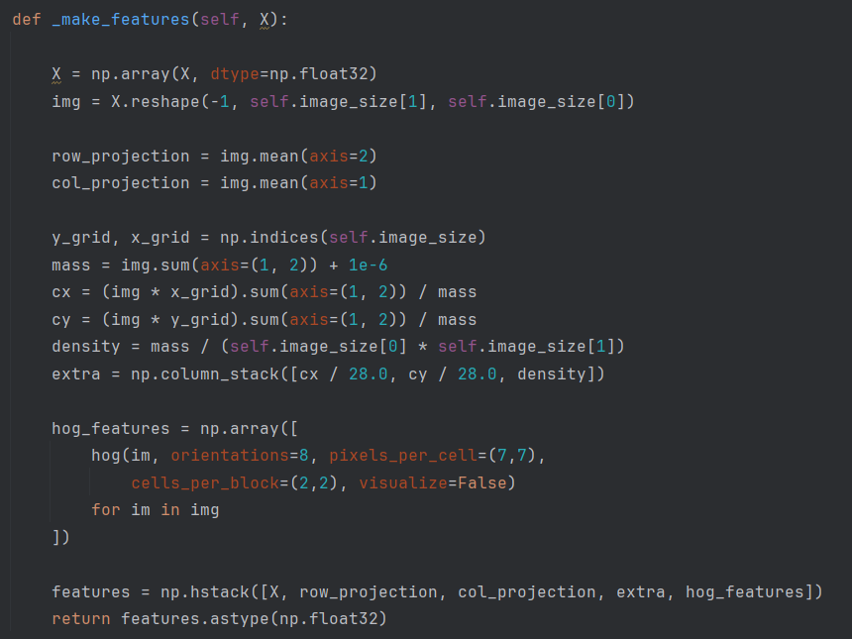
Nearest Neighbors Class Overview
- K-Nearest Neighbors (KNN) is a simple, instance-based algorithm
- No training phase → stores all training data
- Predicts label based on similarity (distance)
- Key idea: similar inputs → similar outputs
- Common distance metric: Euclidean distance

Slide 10
Training Data
MNIST Data
- Dataset of handwritten digits (0–9)
- Each image: 28 × 28 pixels
- Large dataset used for training models
- Standard benchmark for image classification
- Provides labeled examples for comparison
- Store all MNIST images as reference data
- Each image converted into a vector
- Label attached to each training sample
- No model fitting → direct comparison approach
- Used to find nearest neighbors for prediction

Slide 11
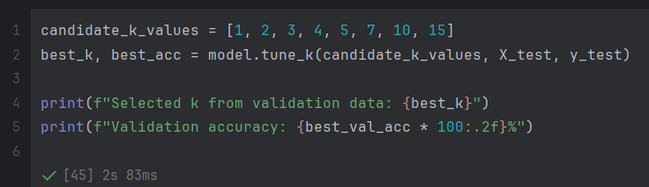
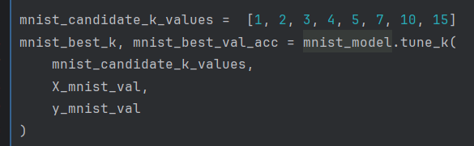
Hyperparameter tuning
- Hyperparameter tuning = choosing the best parameter for a model
- In KNN, K determines how many neighbors are used
Process:
- Try multiple K values (e.g., 1–15)
- Evaluate each using validation data
- Select the K with highest accuracy
Key Insight:
- Small K → sensitive to noise
- Large K → more stable but less precise
Result:
→ Optimal K improves prediction accuracy

Slide 12
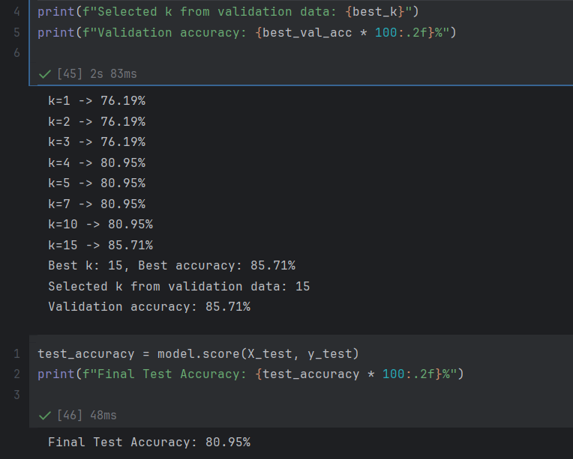
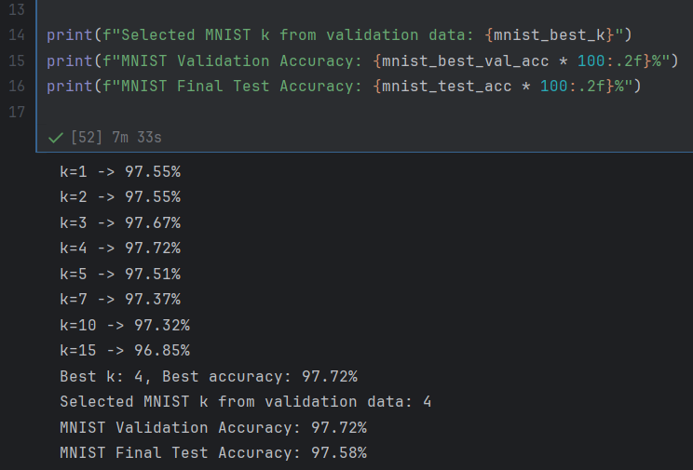
Result
- Input image compared with training data
- K closest samples selected
- Majority vote determines predicted label
- Accuracy depends on preprocessing and K value
- Target performance: high accuracy (e.g., 95%+)

Slide 13
Random Forest

Slide 14
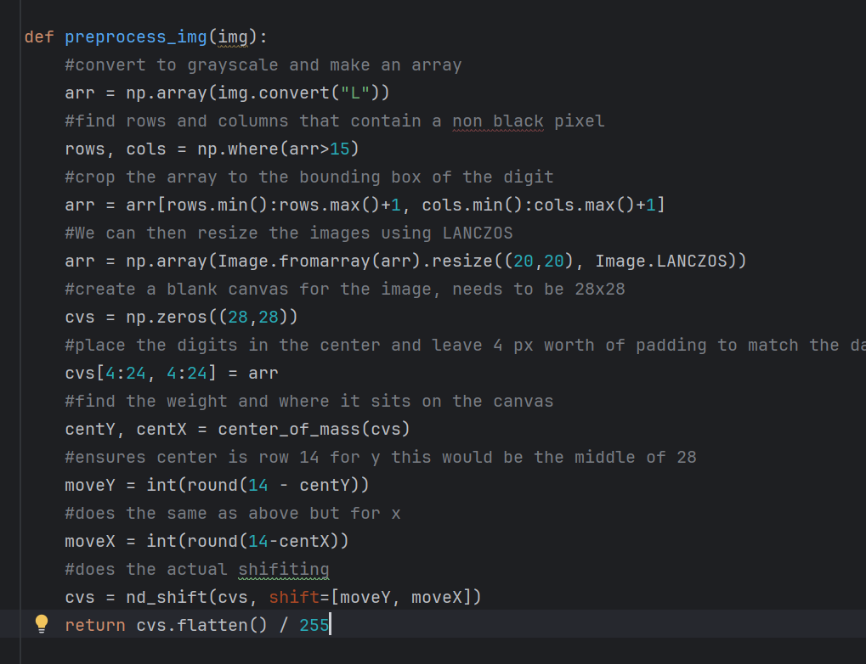
Model
Trained and tested on hand drawn images and MNIST images.
Hand drawn images are preprocessed to match the same format as MNIST images.

Slide 15

Model Accuracy
Much more accurate on MNIST images with a 96-97% accuracy.
Hand drawn images ranged from 70-76% accuracy.
Tested best on hand drawn images when little were used for training and most were used for testing (140 total)

Slide 16
Model Accuracy
Changed values for number of estimators, max depth, and min leafs to see if the results would differ.
Still ended up doing about the same.
The main change that decreased accuracy was decreasing the test size of the hand drawn images, when using 126 hand drawn images to test we got 76% and MNIST was a 97%
When using less hand drawn images for testing and more for training the accuracy of the hand drawn images decreased to 70%, while the MNIST accuracy stayed at 97%.

Slide 17
Challenges
Overall the main problem I had was fine tuning the model, I experimented with multiple different combinations of max depth, estimators, amount of testing data for both MNIST and hand drawn images but the hand drawn images accuracy capped at 76%
There was documentation online about augmenting the training sets but I was not quite sure how to implement that.
If I could do it again I would most likely choose a different model to work with.

